Slide 1
TheraComm
Christian John
Iden Ellia
Joe Samano

Slide 2
Overview of the Presentation
Client
Problem
What is TheraComm?
Software Development Process
Technologies Used
Demo
Future Works

Slide 3
Client
1

Slide 4

Online Therapy Unit Team
A team that is dedicated to improving access to mental health care.

Slide 5
Problem
2

Slide 6



Slide 7
What is TheraComm?
3

Slide 8
What is TheraComm?
TheraComm is an iOS-based mobile application that incorporates the core features of an email system and a chat system.

Slide 9
Software Development Process
4

Slide 10
Project Timeline
1st Semester (September - December)
Project Requirements
Researching and Learning Technologies
Studying the Email API
2nd Semester (January - April)
Development
Testing

Slide 11
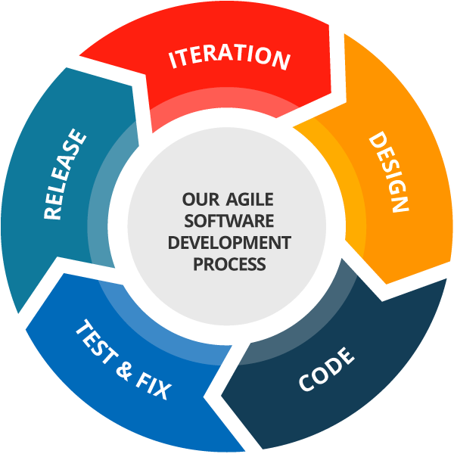
Agile Development
Sprint 1 - Making the Email API work and the Interface of Email System (2 weeks) [2nd Week of Jan until 3rd Week of Jan]
Sprint 2 - Functionalities and Remaining Interface of Email System (2 weeks) [4th Week of Jan until 1st Week of Feb]
Sprint 3 - Interface and Functionalities of Chat System (4 weeks) [3rd Week of Feb until 1st Week of Mar]

Slide 12
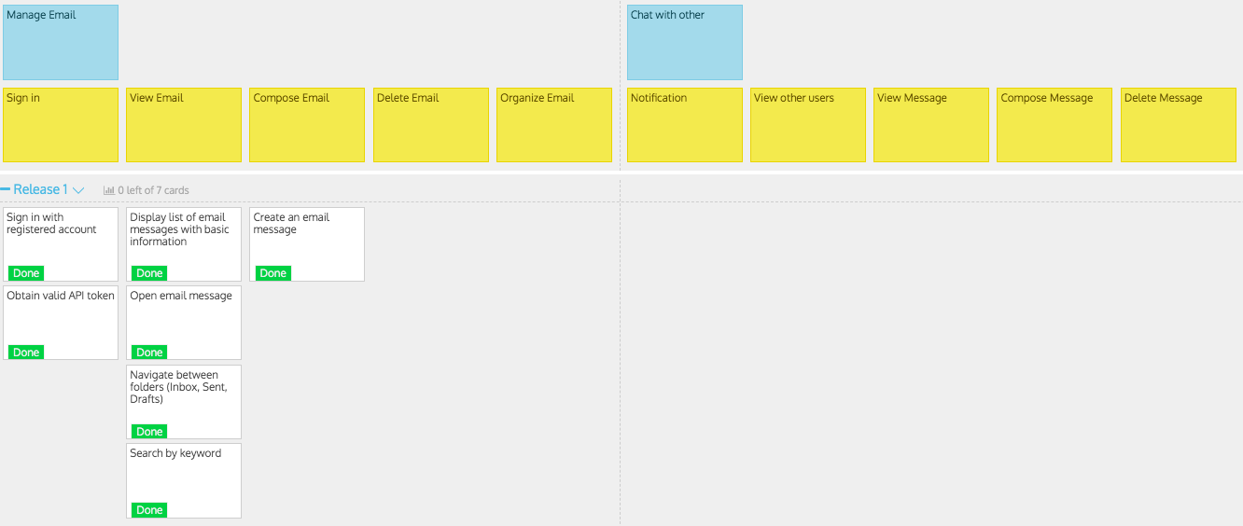
User Story Map - Sprint 1

Slide 13
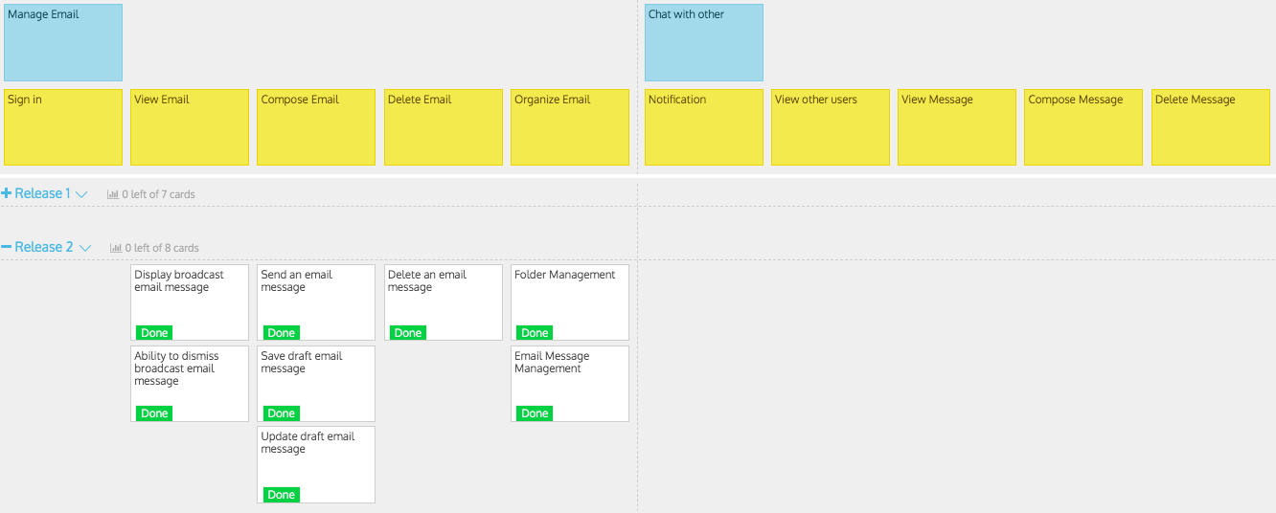
User Story Map (Continued) - Sprint 2

Slide 14
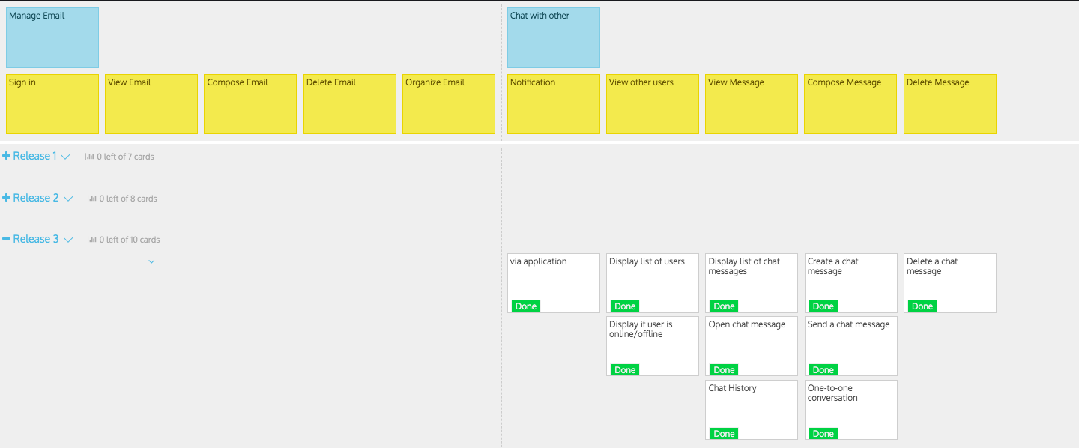
User Story Map (Continued) - Sprint 3

Slide 15
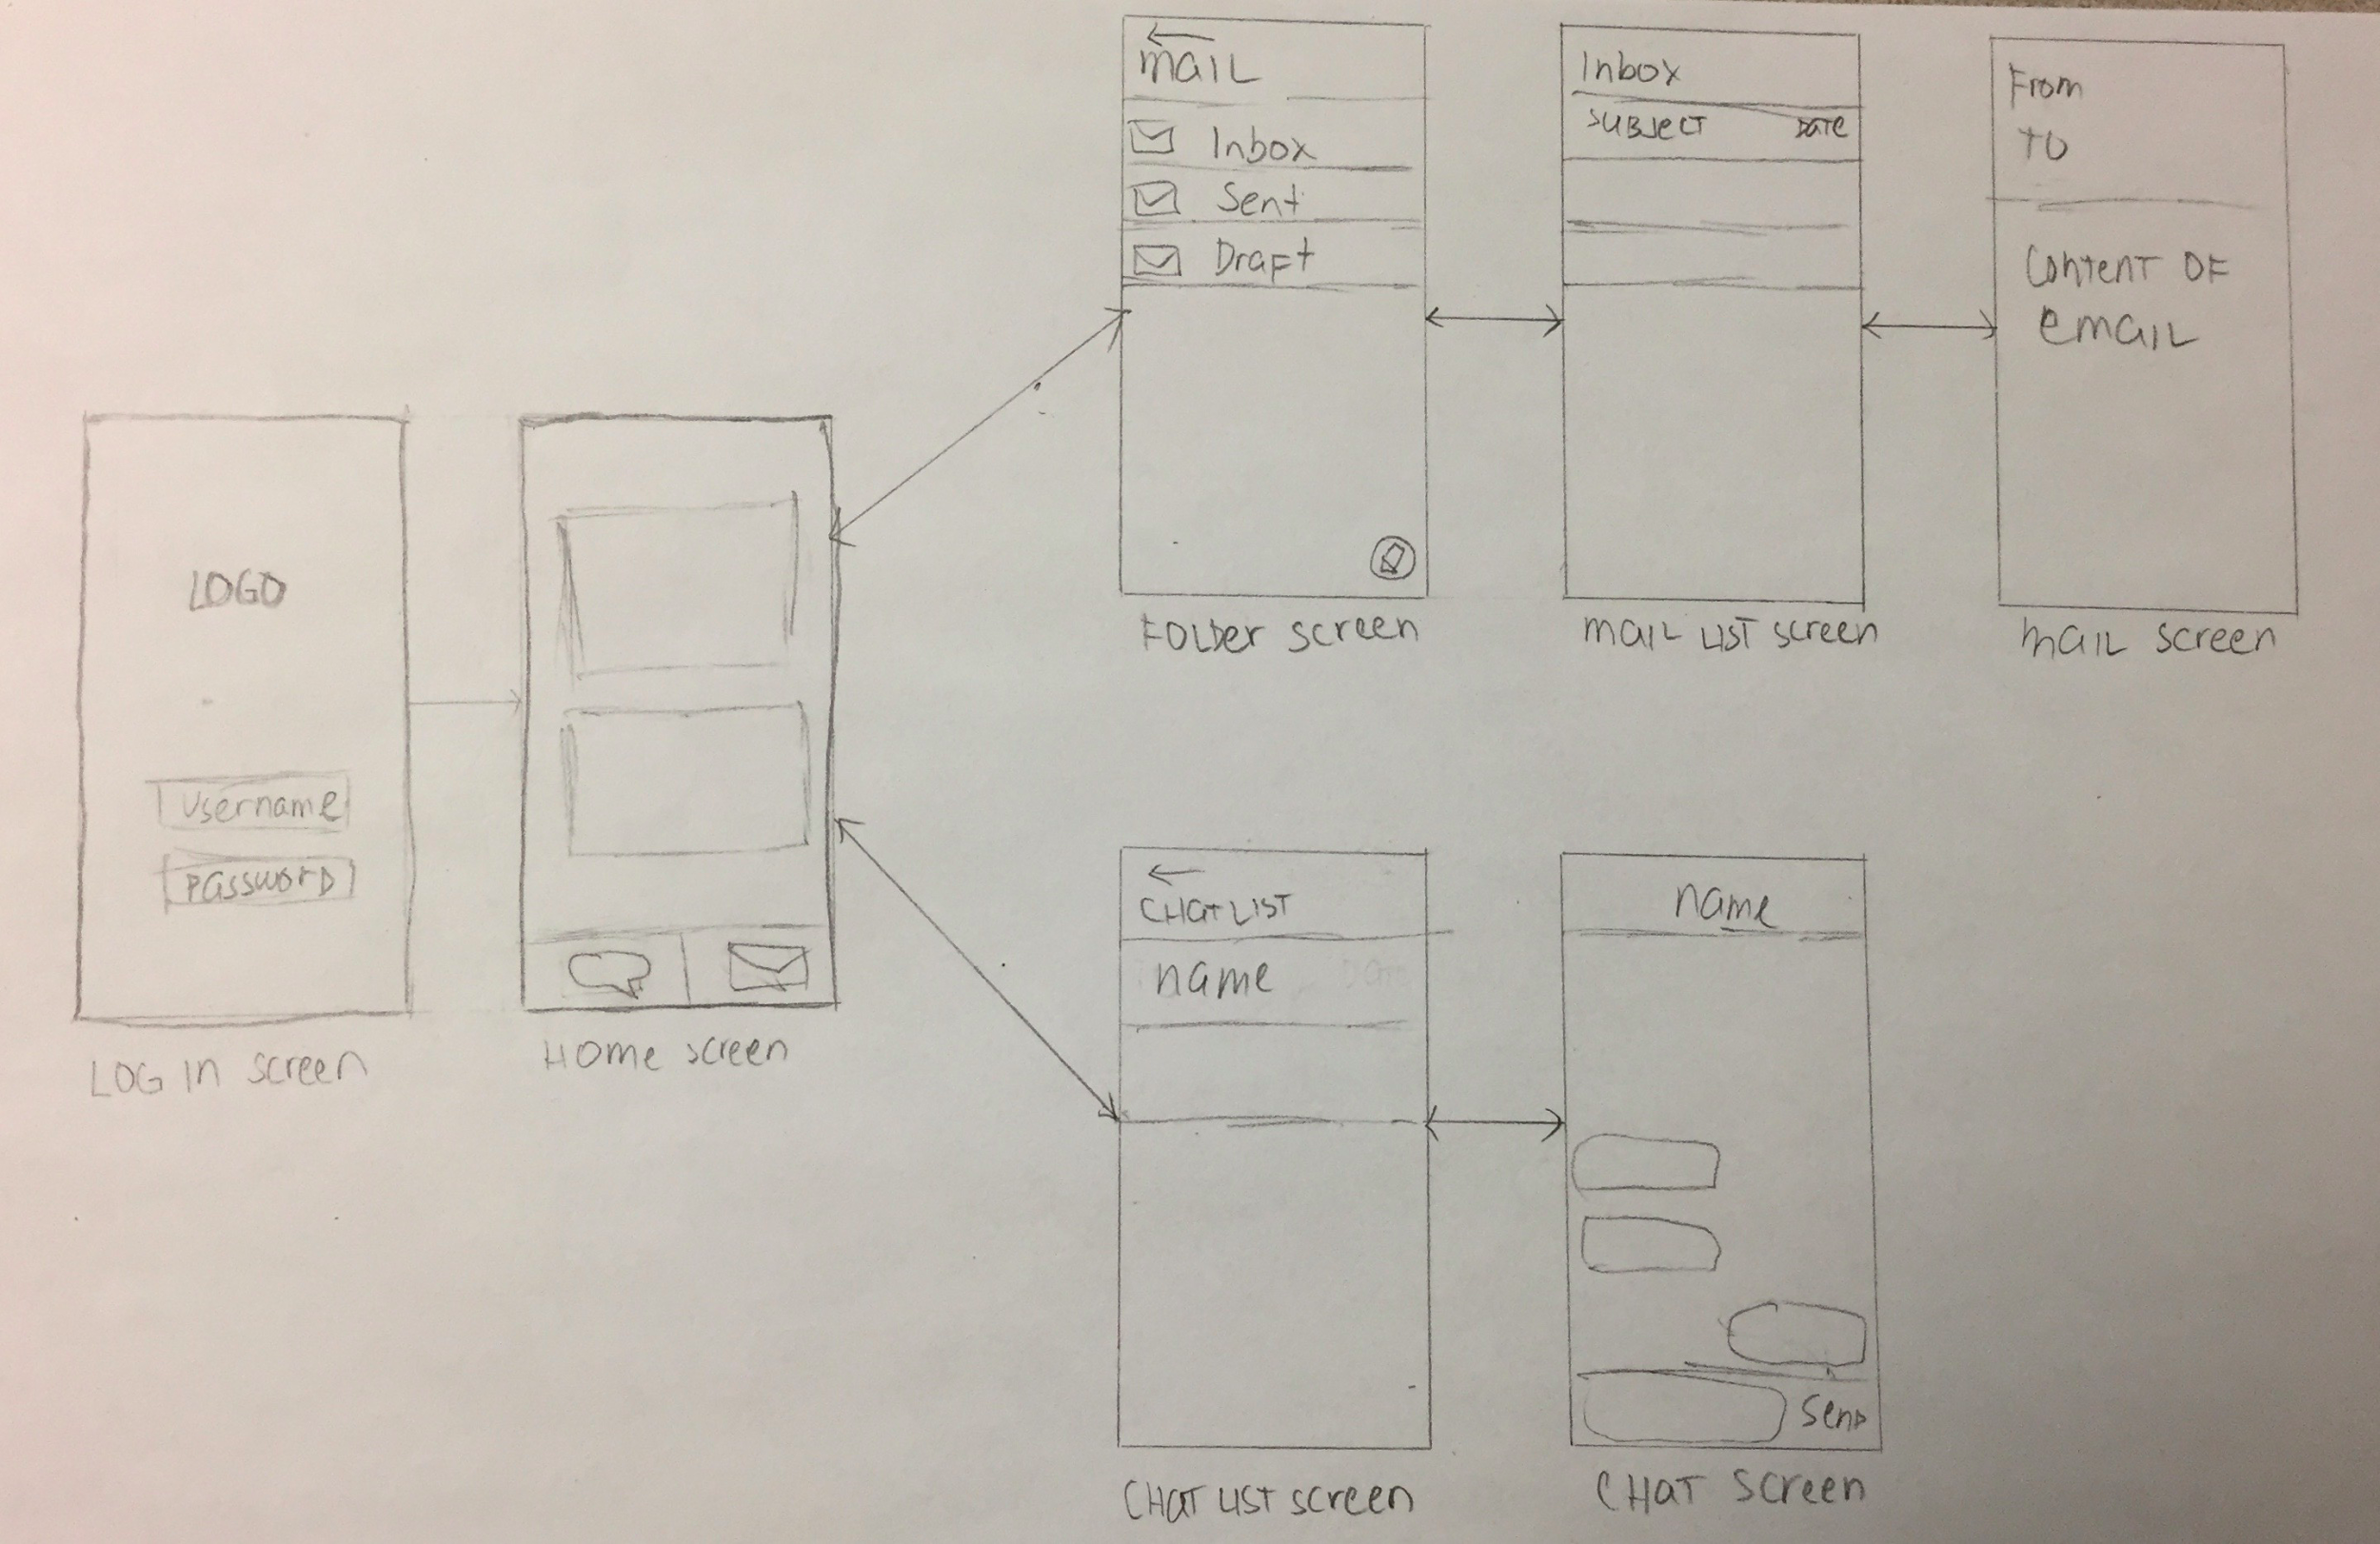
Lo-Fi Prototypes

Slide 16
Testing
Unit Testing
Integration Testing
System Testing
Functional Testing

Slide 17
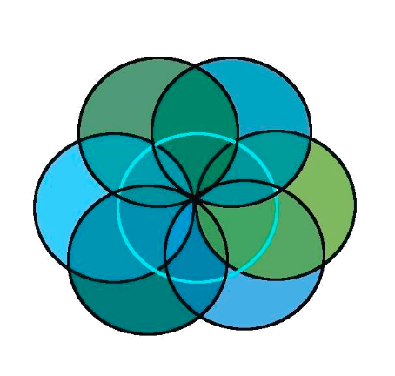









Technologies

Slide 18
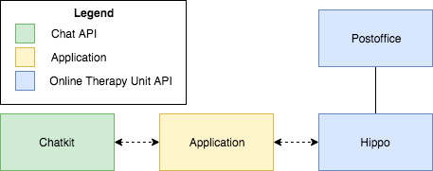
High-Level View of Architecture

Slide 19
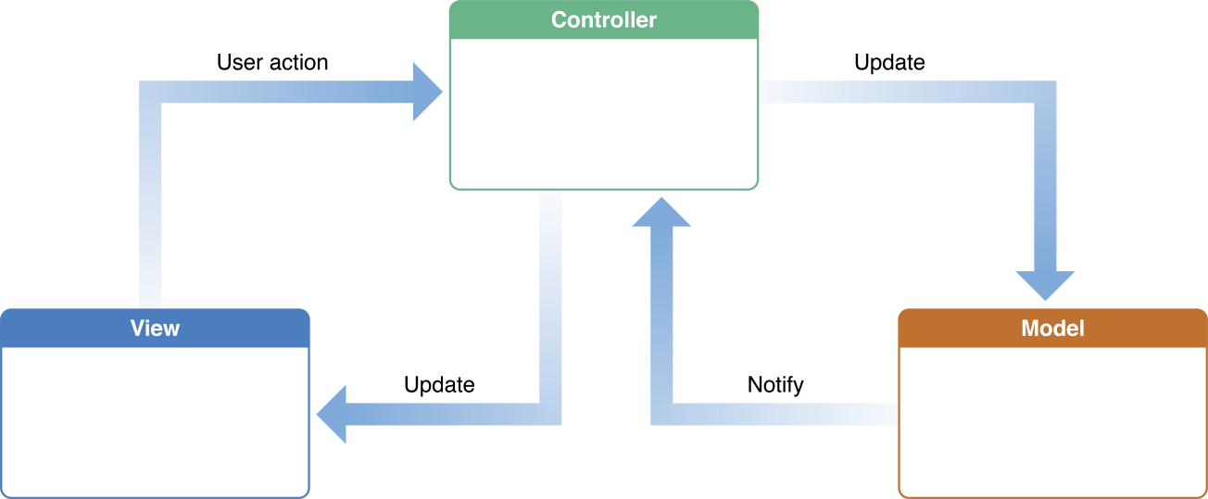
Apple’s MVC - Architectural / Design Pattern

Slide 20
Cost
Labour Cost | 183 hours x $30 / hours | $ 5490.00
Chatkit’s Sandbox Plan |  | $ 0.00
Apple Developer License |  | $ 120.00
Total |  | $ 5610.00

Slide 21
Demo
5

Slide 22
Future Works
6

Slide 23
Future Works
Addition of other features from OTU API:
Viewing Courses
Surveys
Etc.
Add more features to the existing application:
Sub-folders
Video Chat
Etc.

Slide 24
THANKS!
Any questions?

Slide 25
Image References
Depression, https://pixabay.com/illustrations/depression-voices-self-criticism-1250870/
Therapy Session, http://chittagongit.com/icon/therapist-icon-10.html
Agile Development Process, http://www.webmix.fr/en/methodologies
Toggl Logo, https://www.pivotaltracker.com/integrations/toggl-button
Swift Logo, https://zh.m.wikipedia.org/wiki/File:Swift_logo_with_text.svg
Xcode Logo, https://www.macosicongallery.com/icons/xcode-2015-03-13/
Online Therapy Unit Logo, https://www.onlinetherapyuser.ca/
StoriesonBoard Logo, https://storiesonboard.com/
Chatkit Logo, https://pusher.com/chatkit
Laravel Logo, https://logos-download.com/9720-laravel-logo-download.html
MVC Architecture, https://developer.apple.com/library/archive/documentation/General/Conceptual/DevPedia-CocoaCore/MVC.html
Github Logo, https://ievgensaxblog.wordpress.com/2017/11/04/me-on-github/
GitKraken Logo, https://www.gitkraken.com/store
Cocoapods Logo, https://status.cocoapods.org/

Slide 26
Appendix
Link to github: https://github.com/samano2j/Capstone-Project
Link to documentation: https://github.com/samano2j/Capstone-Project/tree/master/Documentation
Link to testing documentation: https://github.com/samano2j/Capstone-Project/tree/master/Documentation/Test%20Plan%20and%20Execution%20Document
Link to User Story Map: https://landofooo.storiesonboard.com/m/theracomm
Link to OTU website: https://www.onlinetherapyuser.ca/
Link to OTU Documentation: http://otu-wiki.cs.uregina.ca/start
Link to Toggl: https://toggl.com/app/timer
Link to Chatkit Features: https://pusher.com/chatkit/pricing
Link to Chatkit Documentation: https://docs.pusher.com/chatkit
Link to Chatkit Data Protection: https://pusher.com/legal/data-protection

